Slide 1
Recap
Java setup
jdk vs jre vs jvm
Java variables
Immutatable & String
Java operators
Java control statements
Arrays
Class & Objects
Constructors
Access modifiers
Non-access modifiers
Internationalization

Slide 2
OOPs Concepts
OOPs (Object Oriented Programming System) - design a program using classes and objects.
Class is a blueprint and collections of Object
Object means a real world entity, has state and behaviour
Inheritance - When one object acquires all the properties and behaviours of parent object
Polymorphism - one task is performed by different ways
Abstraction - Hiding internal details and showing functionality
Encapsulation - Binding (or wrapping) code and data together into a single unit

Slide 3
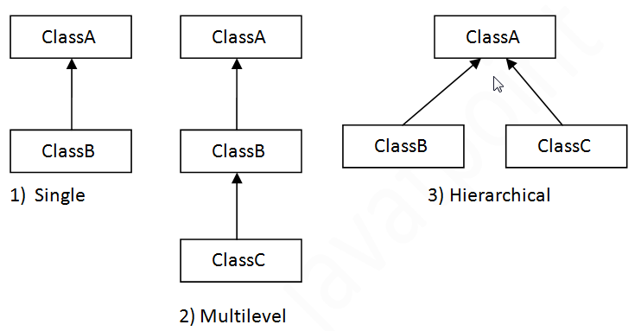
1. Inheritance
IS-A relationship, parent-child relationship
one object acquires all the properties and behaviors of parent object.
extends keyword - making a new class (subclass that derives from an existing class (super class)

Slide 4
Inheritance
Syntax
class Subclass-name extends Superclass-name
{
//methods and fields
}

Slide 5
Inheritance
Define super class Mammal
Mammal has a property name and sing method
public class Mammal {
String name;
public Mammal() {
System.out.println("Making a mammel");
}
public Mammal(String name) {
System.out.println("Mammal's name is " + name);
}
public void sing(String sound, int frequency) {
for (int i=0;i<frequency;i++) {
System.out.println("sound!");
}
}
}

Slide 6
Inheritance
class Cat extends Mammal {
int leg;
int frequency = 2;
public Cat() {
System.out.println("Making a cat");
}
public Cat(String name) {
super(name);
System.out.println("Cat's name is " + name);
}
public Cat(String name, int leg) {
this(name);
this.leg = leg;
System.out.println("Cat's name is " + name);
}
public void sing(String sound) {
for (int i=0;i<frequency;i++) {
System.out.println("Sing: " + sound);
}
}
public void sing(String sound, int frequency) {
for (int i=0;i<frequency;i++) {
System.out.println("sound!");
}
}
}
Define subclass Cat which is a kind of Mammal
Cat has properties leg, singing frequency and sing method

Slide 7
Inheritance
Create execute program
public class Test {
public static void main(String args[]) {
System.out.println("Starting...");
Cat c = new Cat();
Cat cat = new Cat("kitty");
C.sing("meou");
}
}

Slide 8
Explanation
extends keyword – create IS-A relationship between classes
Overloading
super keyword – call a constructor from super class
this keyword – call a constructor from another overloaded constructor in the same class
Constructor chaining
Overriding
Note: Java compiler always inserts call to a no-arg constructor

Slide 9
2. Polymorphism
Any Java object that can pass more than one IS-A test is considered to be polymorphic
Usage: parent class reference is used to refer to a child class object.

Slide 10
Polymorphism example
class Bike {
int speedlimit=90;
void run(){System.out.println("running by a Bike");}
}
class Honda3 extends Bike {
int speedlimit=150;
void run(){System.out.println("running by Honda");}
}
public class Test {
public static void main(String args[]){
Bike obj = new Honda3();
obj.run();
System.out.println(obj.speedlimit);
}
}

Slide 11
Explanation
Object reference (obj) refers to the subclass object and subclass method overrides the Parent class method, subclass method is invoked
Method is overridden but not the data members, polymorphism is not applicable to data members, Object reference (obj) is type Bike, so the data member in Bike will be accessed

Slide 12
3.interface
an abstract type that is used to specify a behavior that classes must implement
Interface keyword
Contain method signature ONLY and constant variables
Cannot be instantiated
A class that implements an interface must implement all of the methods described in the interface, or be an abstract class.
Simulate multiple inheritance – class can extends only 1 class but implement multiply interfaces

Slide 13
interface rules
An interface is not extended by a class; it is implemented by a class.
All interface Methods are implicitly public and abstract.
Interfaces can declare only Constant. All variables inside the Interface must be public, static, final. Variables inside Interface are implicitly public static final.
An interface can extend multiple interfaces.

Slide 14
interface example
interface Printable{
void print();
}
interface Showable{
void show();
}
class TestInterface implements Printable,Showable {
public void print(){System.out.println("print");}
public void show(){System.out.println("show");}
public static void main (String args[]) {
TestInterface obj = new TestInterface();
obj.print();
obj.show();
}
}

Slide 15
4. abstract
abstract member function, means that the function does not have an implementation.
abstract class, is class that can not be instantiated.
abstract class acts as a base for subclasses
When an abstract class is subclassed, the subclass usually provides implementations for all of the abstract methods in its parent class. However, if it does not, then the subclass must also be declared abstract.

Slide 16
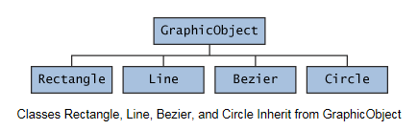
abstract
In an object-oriented drawing application, you can draw circles, rectangles, lines, Bezier curves, and many other graphic objects. These objects all have certain states (for example: position, orientation, line color, fill color) and behaviors (for example: moveTo, rotate, resize, draw) in common. Some of these states and behaviors are the same for all graphic objects (for example: position, fill color, and moveTo). Others require different implementations (for example, resize or draw). All GraphicObjects must be able to draw or resize themselves; they just differ in how they do it.

Slide 17
abstract
abstract class GraphicObject {
int x, y;
...
void moveTo(int newX, int newY) {
...
}
abstract void draw();
abstract void resize();
}
class Circle extends GraphicObject {
void draw() {
...
}
void resize() {
...
}
}
class Rectangle extends GraphicObject {
void draw() {
...
}
void resize() {
...
}
}

Slide 18
abstract vs interface
Abstract class | interface
Abstract class can have abstract and non-abstract methods. | Interface can have only abstract methods.
Abstract class doesn't support multiple inheritance. | Interface supports multiple inheritance.
Abstract class can have final, non-final, static and non-static variables. | Interface has only static and final variables.
Abstract class can have static methods, main method and constructor. | Interface can't have static methods, main method or constructor.
Abstract class can provide the implementation of interface. | Interface can't provide the implementation of abstract class.
The abstract keyword is used to declare abstract class. | The interface keyword is used to declare interface.
7) Example: public abstract class Shape{ public abstract void draw(); } | Example: public interface Drawable{ void draw(); }

Slide 19
Which should you use, abstract classes or interfaces?
Consider using abstract classes if any of these statements apply to your situation:
You want to share code among several closely related classes.
You expect that classes that extend your abstract class have many common methods or fields, or require access modifiers other than public (such as protected and private).
You want to declare non-static or non-final fields. This enables you to define methods that can access and modify the state of the object to which they belong.
Consider using interfaces if any of these statements apply to your situation:
You expect that unrelated classes would implement your interface. For example, the interfaces Runnable is implemented by many unrelated classes.
You want to specify the behavior of a particular data type, but not concerned about who implements its behavior.
You want to take advantage of multiple inheritance of type.

Slide 20
5. Encapsulation
Encapsulation is one of the four fundamental OOP concepts. The other three are inheritance, polymorphism, and abstraction.
wrapping the data (variables) and code acting on the data (methods) together as a single unit.
the variables of a class will be hidden from other classes, and can be accessed only through the methods of their current class, therefore it is also known as data hiding.

Slide 21
Encapsulation
public class Person {
private String empName;
private int empAge;
public String getEmpName(){
return empName;
}
public int getEmpAge(){
return empAge;
}
public void setEmpAge(int newValue){
empAge = newValue;
}
public void setEmpName(String newValue){
empName = newValue;
}
}
public class Test {
public static void main(String args[]){
Person obj = new Person ();
obj.setEmpName("Mario");
obj.setEmpAge(32);
System.out.println("Employee Name: " + obj.getEmpName());
System.out.println("Employee Age: " + obj.getEmpAge());
}
}
Declare the variables of a class as private.
Provide public setter and getter methods to modify and view the variables values.

Slide 22
Encapsulation
Benefits
The fields of a class can be made read-only or write-only.
A class can have total control over what is stored in its fields.
The users of a class do not know how the class stores its data. A class can change the data type of a field and users of the class do not need to change any of their code.

Slide 23
6. Call by value
public class CallByValue {
public static void main(String[] args) {
int x =3;
System.out.println("Value of x before calling increment() is "+x);
increment(x);
System.out.println("Value of x after calling increment() is "+x);
}
public static void increment (int a) {
System.out.println("Value of a before incrementing is "+a);
a= a+1;
System.out.println("Value of a after incrementing is "+a);
}
}

Slide 24
7. Call by reference
class Number {
int x;
}
public class CallByReference {
public static void main ( String[] args ) {
Number a = new Number();
a.x=3;
System.out.println("Value of a.x before calling increment() is "+a.x);
increment(a);
System.out.println("Value of a.x after calling increment() is "+a.x);
}
public static void increment(Number n) {
System.out.println("Value of n.x before incrementing x is "+n.x);
n.x=n.x+1;
System.out.println("Value of n.x after incrementing x is "+n.x);
}
}

Slide 25
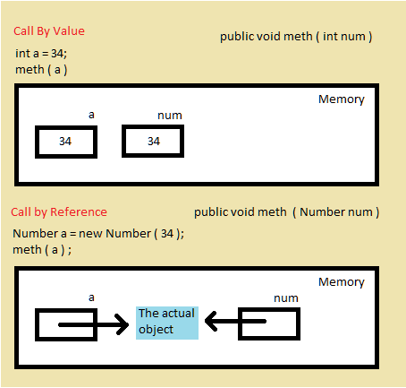
Explanation
Call by value – the argument is copied into the parameters in the method
Call by reference – the object reference is passed to the method, no copy is made

Slide 26
8. Enum
Java Enum is a special Java type used to define collections of constants, methods
enum type is a special kind of Java class
the names of an enum type's fields are in uppercase letters.
public enum Level {
HIGH,
MEDIUM,
LOW
}

Slide 27
Enums in if Statements
Level level = ... //assign some Level constant to it
if( level == Level.HIGH) {
} else if( level == Level.MEDIUM) {
} else if( level == Level.LOW) {
}

Slide 28
Enums in switch Statements
Level level = ... //assign some Level constant to it
switch (level) {
case HIGH : ...; break;
case MEDIUM : ...; break;
case LOW : ...; break;
}

Slide 29
Enum Iteration
You can obtain an array of all the possible values of a Java enum type by calling its static values() method.
All enum types get a static values() method automatically by the Java compiler.
for (Level level : Level.values()) {
System.out.println(level);
}

Slide 30
Enum Fields
You can add fields to a Java enum
The field values must be supplied to the constructor of the enum when defining the constants.
The enum constructor must be either private or package scope (default).
public enum Level {
HIGH (3), //calls constructor with value 3
MEDIUM(2), //calls constructor with value 2
LOW (1) //calls constructor with value 1
; // semicolon needed when fields / methods follow
private final int levelCode;
private Level(int levelCode) {
this.levelCode = levelCode;
}
}

Slide 31
8. Nested Class
class within another class
nested class – class written within a class
Output class – class holds the inner class
class OuterClass {
...
class NestedClass {
...
}
}

Slide 32
Nested Class
Nested classes are divided into two categories
static (called static nested class)
non-static (called inner class)
Non-static nested classes (inner classes) have access to other members of the enclosing class, even if they are declared private.
Static nested classes do not have access to other members of the enclosing class.
As a member of the OuterClass, a nested class can be declared private, public, protected, or package private. (Recall that outer classes can only be declared public or package private.)

Slide 33
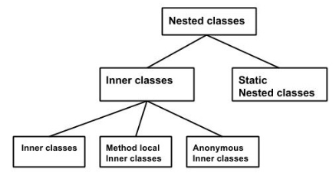
Inner Classes (Non-static Nested Classes)
Inner Class
Method-local Inner Class (Local Class)
Anonymous Inner Class

Slide 34
Inner Class
write a class within a class
public class OuterClass {
int num;
private class Inner_Demo { //inner class
public void print() {
System.out.println("This is an inner class");
}
}
void display_Inner() {
Inner_Demo inner = new Inner_Demo();
inner.print();
}
public static void main(String args[]) {
OuterClass outer = new OuterClass();
outer.display_Inner();
}
}

Slide 35
Inner Class
inner classes are also used to access the private members of a class
public class OuterDemo {
private int num = 12;
private class InnerClass {
public void getNum() {
System.out.println("Num value of outer class is: " + num);
}
}
public static void main(String [] args) {
OuterDemo d = new OuterDemo();
InnerClass i = d.new InnerClass();
i.getNum();
}
}

Slide 36
Method-local Inner Class (Local Class)
a class defined in a block (e.g. method body, for loop or if clause)
Like local variables, the scope of the inner class is restricted within the method.
A method-local inner class can be instantiated only within the method where the inner class is defined.
A local class has access to the members of its enclosing class
a local class can only access local variables that are declared final.

Slide 37
Local Class
public class MethodLocalInnerClass {
void my_Method(){
final int num = 23;
class MethodInner_Demo {
public void print(){
System.out.println("This is method inner class "+num);
}
}//end of inner class
//Accessing the inner class
MethodInner_Demo inner = new MethodInner_Demo();
inner.print();
}
public static void main(String args[]){
MethodLocalInnerClass outer = new MethodLocalInnerClass();
outer.my_Method();
}
}

Slide 38
Anonymous Inner Classes
An inner class declared without a class name
declare and instantiate them at the same time
used whenever you need to override the method of a class or an interface.
typically declared as either subclasses of an existing class, or as implementations of some interface

Slide 39
anonymous inner class example using class
abstract class Person {
abstract void eat();
}
public class TestAnonymousInner{
static String n = "boys";
static String v = "ABC";
public static void main(String args[]){
final String name = "girls";
Person p=new Person(){
String v = "DEF";
void eat(){
System.out.println("Hello " + n);
System.out.println("Hello " + name);
System.out.println("Hello " + this.v);
System.out.println("Hello " + TestAnonymousInner.this.v);
}
};
p.eat();
}
}

Slide 40
anonymous inner class example using interface
interface Eatable{
void eat();
}
class TestAnnonymousInner1{
static String n = "boys";
static String v = "ABC";
public static void main(String args[]){
final String name = "girls";
Eatable p=new Eatable(){
String v = "DEF";
public void eat(){
System.out.println("Hello " + n);
System.out.println("Hello " + name);
System.out.println("Hello " + this.v);
System.out.println("Hello " + TestAnnonymousInner1.this.v);
}
};
p.eat();
}
}

Slide 41
Anonymous Inner Classes explanation
An anonymous class has access to the members of its enclosing class
An anonymous class cannot access local variables in its enclosing scope that are not declared as final
Like a nested class, a declaration of a type (such as a variable) in an anonymous class shadows any other declarations in the enclosing scope that have the same name.
You cannot declare static initializers or member interfaces in an anonymous class.
An anonymous class can have static members provided that they are constant variables.
you cannot declare constructors in an anonymous class.

Slide 42
Static Nested Class
nested class which is a static member of the outer class.
can be accessed without instantiating the outer class, using other static members
a static nested class does not have access to the instance variables and methods of the outer class.
class MyOuter {
static class Nested_Demo{
}
}

Slide 43
Static Nested Class
public class StaticNestedClass {
static class Nested_Demo{
public void my_method(){
System.out.println("This is my nested class");
}
}
public static void main(String args[]){
StaticNestedClass.Nested_Demo nested = new StaticNestedClass.Nested_Demo();
nested.my_method();
}
}

Slide 44
9. Exception
An exception is an event, which occurs during the execution of a program, that disrupts the normal flow of the program's instructions
Reason for exception occurs
Invalid data e.g. null
IO read/write error
Network/resources connection failed
JVM out of memory

Slide 45
Exception Category
Every Exception in Java is sub type of Exception class which is subclass of Throwable
Checked Exception
subclass’s of Exception excluding RuntimeException and its subclasses.
Should be handled
Checked at compile time
Unchecked Exception
Occurs at execution
RuntimeException/Error and their subclasses
Program bugs
Errors
Beyond the control of user/programmer
JVM out of memory

Slide 46
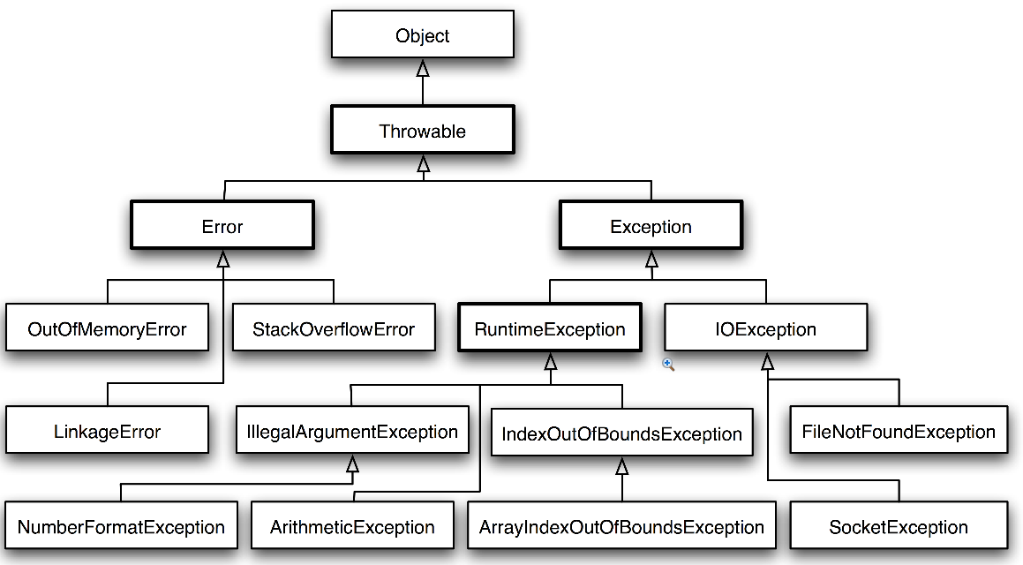
Exception Hierarchy

Slide 47
Exception handling
try: try is used to define block of code where exception can occur.
catch: catch is used to match specific type of exception. There could be more than one catch clause for one try block.
finally: finally determine block of code which will always execute after try block. Even in case of Exception.
try {
throw new IOException();
} catch (IOException e) {
// Handle only IO Exception
// This block will get executed only in case of IOException
} catch (Exception e) {
// Handle only all other type of exception
// This block will get executed in case of all exception except IOException
} finally {
System.out.println("This block will get executed no matter exception occur or not");
}

Slide 48
Exception example1
public class TestException {
public static void main(String[] args) {
try{
int a[] = new int[2];
System.out.println("Access element three :" + a[3]);
}catch(ArrayIndexOutOfBoundsException e){
System.out.println("Exception thrown :" + e);
e.printStackTrace();
}
System.out.println("Out of the block");
}
}

Slide 49
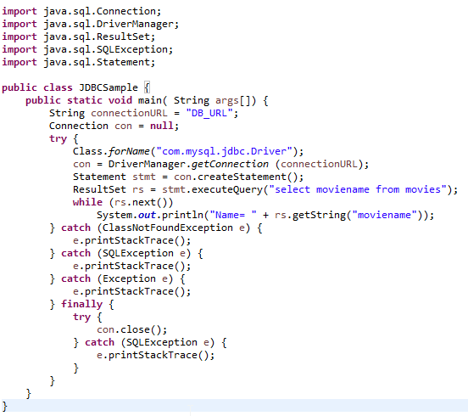
Typical example

Slide 50
Java 7 Catching
catch(IOException | SQLException | Exception ex){
logger.error(ex);
ex.printStackTrace();
}

Slide 51
throws/throw Keywords
If a method does not handle a checked exception, the method must declare it using the throws keyword.
The throws keyword appears at the end of a method's signature.
You can throw an exception, either a newly instantiated one or an exception that you just caught, by using the throw keyword.

Slide 52
throws/throw Keywords
import java.io.*;
public class className
{
public void deposit(double amount) throws RemoteException
{
// Method implementation
throw new RemoteException();
}
//Remainder of class definition
}
throws is used to postpone the handling of a checked exception and throw is used to invoke an exception explicitly.

Slide 53
Exception Propagation
It is not required to handle all exception thrown by try block in catch block (As it is not required block).
In case catch block doesn’t handle exception thrown by try block, it will be propagated to method where this method was called from.
public Object pop() {
Object obj;
if (size == 0) {
throw new EmptyStackException();
}
obj = objectAt(size - 1);
setObjectAt(size - 1, null);
size--;
return obj;
}
Note: EmptyStackException is not a checked exception, so pop is not required to state that it might occur.

Slide 54
User-defined Exception
All exceptions must be a child of Throwable.
If you want to write a checked exception that is automatically enforced by the Handle or Declare Rule, you need to extend the Exception class.
If you want to write a runtime exception, you need to extend the RuntimeException class.

Slide 55
User-defined Exception
import java.io.*;
public class InsufficientFundException extends Exception {
private double amount;
public InsufficientFundsException(double amount) {
this.amount = amount;
}
public double getAmount() {
return amount;
}
}
public class CheckingAccount {
private double balance;
public void withdraw(double amount) throws InsufficientFundException {
if(amount <= balance) {
balance -= amount;
} else {
double needs = amount - balance;
throw new InsufficientFundException(needs);
}
}
}

Slide 56
Question
Is there anything wrong with this exception handler as written? Will this code compile?
try {
} catch (Exception e) {
} catch (ArithmeticException a) {
}

Slide 57
Question
Modify the following cat method so that it will compile:
public static void cat(File file) {
RandomAccessFile input = null;
String line = null;
try {
input = new RandomAccessFile(file, "r");
while ((line = input.readLine()) != null) {
System.out.println(line);
}
return;
} finally {
if (input != null) {
input.close();
}
}
}

Slide 58
10. File & I/O
java.io package
A stream can be defined as a sequence of data
InPutStream: The InputStream is used to read data from a source.
OutPutStream: the OutputStream is used for writing data to a destination.

Slide 59
Byte Streams
perform input and output of 8-bit bytes
All byte stream classes are descended from InputStream and OutputStream
the most frequently used classes are FileInputStream and FileOutputStream

Slide 60
Byte Streams
import java.io.*;
public class CopyFile {
public static void main(String args[]) throws IOException
{
FileInputStream in = null;
FileOutputStream out = null;
try {
in = new FileInputStream("input.txt");
out = new FileOutputStream("output.txt");
int c;
while ((c = in.read()) != -1) {
out.write(c);
}
} finally {
if (in != null) {
in.close();
}
if (out != null) {
out.close();
}
}
}
}

Slide 61
Character Streams
Java Byte streams are used to perform input and output of 8-bit bytes, where as Java Character streams are used to perform input and output for 16-bit unicode.
All character stream classes are descended from Reader and Writer.
The most frequently used classes are , FileReader and FileWriter.

Slide 62
Character Streams
import java.io.*;
public class CopyFile {
public static void main(String args[]) throws IOException
{
FileReader in = null;
FileWriter out = null;
try {
in = new FileReader("input.txt");
out = new FileWriter("output.txt");
int c;
while ((c = in.read()) != -1) {
out.write(c);
}
}finally {
if (in != null) {
in.close();
}
if (out != null) {
out.close();
}
}
}
}

Slide 63
Buffered Streams
To reduce no. of disk/network access
Buffered input streams read data from a memory area known as a buffer; the native input API is called only when the buffer is empty.
Buffered output streams write data to a buffer, and the native output API is called only when the buffer is full.

Slide 64
Buffered Streams
A program can convert an unbuffered stream into a buffered stream using the wrapping idiom we've used several times now, where the unbuffered stream object is passed to the constructor for a buffered stream class. Here's how you might modify the constructor invocations in the CopyCharacters example to use buffered I/O:
inputStream = new BufferedReader(new FileReader("xanadu.txt"));
outputStream = new BufferedWriter(new FileWriter("characteroutput.txt"));
To flush a stream manually, invoke its flush method.

Slide 65
10. Collections
A collection is an object that groups multiple elements into a single unit
used to store, retrieve, manipulate, and communicate aggregate data.
A collections framework is a unified architecture for representing and manipulating collections.
Interfaces: abstract data types that represent collections.
Implementations: concrete implementations of the collection interfaces.
Algorithms: methods that perform useful computations, such as searching and sorting, on objects that implement collection interfaces. The algorithms are said to be polymorphic: same method can be used on many different implementations of the appropriate collection interface. In essence, algorithms are reusable functionality.

Slide 66
Core Collection interfaces
Category | Description
Collection | the root of the collection hierarchy. A collection represents a group of objects known as its elements.
Set | extends Collection, a collection that cannot contain duplicate elements.
List | extends Collection, an ordered collection (sometimes called a sequence). Lists can contain duplicate elements.
Queue | extends Collection, a collection used to hold multiple elements prior to processing. Items are added an one end and removed from the other.
Deque | extends Collection, a collection used to hold multiple elements prior to processing. Items can be added to or removed from either end of the queue.
Map | an object that maps keys to values. A Map cannot contain duplicate keys; each key can map to at most one value.
SortedSet | extends Collection, a Set that maintains its elements in ascending order.
SortedMap | a Map that maintains its mappings in ascending key order.

Slide 67
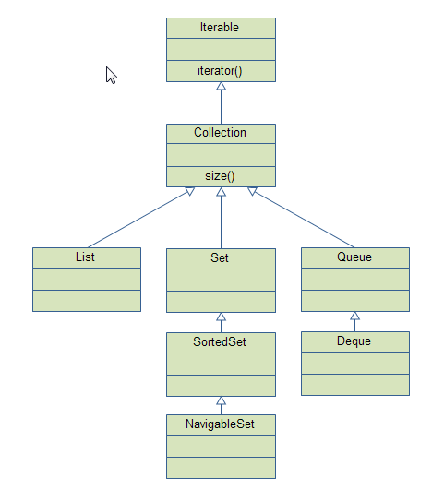
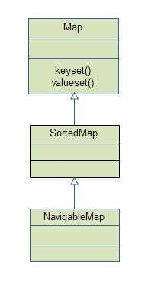
Collection & Map interfaces

Slide 68
ArrayList
Use dynamic array to store elements
Can contain duplicate elements
Maintains insertion order
Non synchronized
Allow random access due to index basis
Manipulation is slow because a lot shifting in case of element removal
import java.util.*;
public static void main(String args[]) {
List<String> list = new ArrayList<String>();
list.add("ABC");
list.add("DEF");
list.add("xyz");
// use iterator to traverse arraylist
for (Iterator<String> it = list.iterator();
it.hasNext(); ) {
System.out.println(it.next());
}
//use for-each loop
for (String s : list) {
System.out.println(s);
}
}

Slide 69
LinkedList
Use double linked list to store elements
Can contain duplicate elements
Maintains insertion order
Non synchronized
Allow random access due to index basis
Manipulation is fast because no shifting needed
implements List and Deque interfaces
import java.util.*;
public static void main(String args[]) {
List<String> list = new LinkedList<String>();
list.add("ABC");
list.add("DEF");
list.add("xyz");
// use iterator to traverse arraylist
for (Iterator<String> it = list.iterator();
it.hasNext(); ) {
System.out.println(it.next());
}
//use for-each loop
for (String s : list) {
System.out.println(s);
}
}

Slide 70
HashSet
uses hashtable to store the elements.
extends AbstractSet class and implements Set interface.
contains unique elements only.
Note: List can contain duplicate elements whereas Set contains unique elements only.
import java.util.*;
public static void main(String args[]) {
Set<String> list = new HashSet<String>();
list.add("ABC");
list.add("DEF");
list.add("xyz");
// use iterator to traverse arraylist
for (Iterator<String> it = list.iterator();
it.hasNext(); ) {
System.out.println(it.next());
}
//use for-each loop
for (String s : list) {
System.out.println(s);
}
}

Slide 71
LinkedHashSet
contains unique elements only like HashSet.
extends HashSet class and implements Set interface.
maintains insertion order.
import java.util.*;
public static void main(String args[]) {
Set<String> list = new LinkedHashSet<String>();
list.add("ABC");
list.add("DEF");
list.add("xyz");
// use iterator to traverse arraylist
for (Iterator<String> it = list.iterator();
it.hasNext(); ) {
System.out.println(it.next());
}
//use for-each loop
for (String s : list) {
System.out.println(s);
}
}

Slide 72
TreeSet
contains unique elements only like HashSet.
implements NavigableSet interface that extends the SortedSet interface.
maintains ascending order.
Sorted(Uses Tree Structure)
import java.util.*;
public static void main(String args[]) {
Set<String> list = new TreeSet<String>();
list.add("ABC");
list.add("DEF");
list.add("xyz");
// use iterator to traverse arraylist
for (Iterator<String> it = list.iterator();
it.hasNext(); ) {
System.out.println(it.next());
}
//use for-each loop
for (String s : list) {
System.out.println(s);
}
}

Slide 73
PriorityQueue
import java.util.Iterator;
import java.util.PriorityQueue;
public class TestCollection {
public static void main(String args[]) {
PriorityQueue<String> queue = new PriorityQueue<String>();
queue.add("A");
queue.add("AB");
queue.add("ABC");
queue.add("ABCD");
System.out.println("head:"+queue.element());
System.out.println("head:"+queue.peek());
System.out.println("iterating the queue elements:");
for (Iterator<String> it = queue.iterator(); it.hasNext(); ) {
System.out.println(it.next());
}
queue.remove();
queue.poll();
System.out.println("after removing two elements:");
for (Iterator<String> it = queue.iterator(); it.hasNext(); ) {
System.out.println(it.next());
}
}
}
stores its elements internally according to their natural order (if they implement Comparable),
or according to a Comparator passed to it.

Slide 74
HashMap
Contains values based on key.
Implements the Map interface and extends AbstractMap class
Contains only unique elements
Allows one null key and multiple null values
Maintains no order
import java.util.HashMap;
import java.util.Map;
public class TestHashMap {
public static void main(String args[]){
Map<Integer,String> hm = new HashMap<Integer,String>();
hm.put(100,"Amit");
hm.put(101,"Vijay");
hm.put(102,"Rahul");
for(Map.Entry m:hm.entrySet()){
System.out.println(m.getKey()+" "+m.getValue());
}
}
}

Slide 75
LinkedHashMap
Contains values based on key.
Implements the Map interface and extends HashMap class
Contains only unique elements
Allows one null key and multiple null values
same as HashMap but maintains insertion order
import java.util.HashMap;
import java.util.Map;
public class TestHashMap {
public static void main(String args[]){
Map<Integer,String> hm = new LinkedHashMap<Integer,String>();
hm.put(100,"Amit");
hm.put(101,"Vijay");
hm.put(102,"Rahul");
for(Map.Entry m:hm.entrySet()){
System.out.println(m.getKey()+" "+m.getValue());
}
}
}

Slide 76
TreeMap
implements the Map interface by using a tree
provides an efficient means of storing key/value pairs in sorted order
allows rapid retrieval
guarantees that its elements will be sorted in ascending key order
import java.util.Map;
import java.util.TreeMap;
public class TestTreeMap {
public static void main(String args[]) {
// Create a hash map
TreeMap<String, Double> tm = new TreeMap<String, Double>();
// Put elements to the map
tm.put("Zara", new Double(3434.34));
tm.put("Mahnaz", new Double(123.22));
tm.put("Ayan", new Double(1378.00));
tm.put("Daisy", new Double(99.22));
tm.put("Qadir", new Double(-19.08));
// loop entry
for(Map.Entry me:tm.entrySet()){
System.out.println(me.getKey() + ": " + me.getValue());
}
System.out.println();
// Deposit 1000 into Zara's account
double balance = ((Double)tm.get("Zara")).doubleValue();
tm.put("Zara", new Double(balance + 1000));
System.out.println("Zara's new balance: " +
tm.get("Zara"));
}
}

Slide 77
Hashtable
Hashtable stores key/value pairs in a hash table. When using a Hashtable, you specify an object that is used as a key, and the value that you want linked to that key. The key is then hashed, and the resulting hash code is used as the index at which the value is stored within the table.
Allows only unique elements
Synchronized
Key and value should not be null
import java.util.Hashtable;
import java.util.Map;
public class TestHashtable {
public static void main(String args[]){
Hashtable<Integer,String> hm=new Hashtable<Integer,String>();
hm.put(100,"A");
hm.put(102,"AB");
hm.put(101,"ABC");
hm.put(103,"ABCD");
for(Map.Entry m:hm.entrySet()){
System.out.println(m.getKey()+" "+m.getValue());
}
}
}

Slide 78
Hashtable vs HashMap
HashMap | Hashtable
1) HashMap is non synchronized. It is not-thread safe and can't be shared between many threads without proper synchronization code. | Hashtable is synchronized. It is thread-safe and can be shared with many threads.
2) HashMap allows one null key and multiple null values. | Hashtable doesn't allow any null key or value.
3) HashMap is a new class introduced in JDK 1.2. | Hashtable is a legacy class.
4) Performance of HashMap is fast. | Hashtable is slow.
5) We can make the HashMap as synchronized by calling this code Map m = Collections.synchronizedMap(hashMap); | Hashtable is internally synchronized and can't be unsynchronized.
6) HashMap is traversed by Iterator. | Hashtable is traversed by Enumerator and Iterator.
HashMap | Hashtable

Slide 79
11. Comparable
In package java.lang
used to order the objects of user-defined class
only one method named compareTo(Object).
class Student implements Comparable {
int rollno;
String name;
int age;
Student(int rollno,String name,int age){
this.rollno=rollno;
this.name=name;
this.age=age;
}
public int compareTo(Object obj){
Student st=(Student)obj;
if(age==st.age)
return 0;
else if(age>st.age)
return 1;
else
return -1;
}
}
import java.util.*;
import java.io.*;
class TestSort3{
public static void main(String args[]){
ArrayList al=new ArrayList();
al.add(new Student(101,"Vijay",23));
al.add(new Student(106,"Ajay",27));
al.add(new Student(105,"Jai",21));
Collections.sort(al);
Iterator itr=al.iterator();
while(itr.hasNext()){
Student st=(Student)itr.next();
System.out.println(st.rollno+""+st.name+""+st.age);
}
}
}

Slide 80
Comparator
used to order the objects of user-defined class.
in java.util package and contains 2 methods compare(Object obj1,Object obj2) and equals(Object element).

Slide 81
Comparator Example
class Student{
int rollno;
String name;
int age;
Student(int rollno,String name,int age){
this.rollno=rollno;
this.name=name;
this.age=age;
}
}
import java.util.*;
class AgeComparator implements Comparator{
public int Compare(Object o1,Object o2){
Student s1=(Student)o1;
Student s2=(Student)o2;
if(s1.age==s2.age)
return 0;
else if(s1.age>s2.age)
return 1;
else
return -1;
}
}
import java.util.*;
class NameComparator implements
Comparator{
public int Compare(Object o1,Object o2){
Student s1=(Student)o1;
Student s2=(Student)o2;
return s1.name.compareTo(s2.name);
}
}

Slide 82
Comparator Example
import java.util.*;
import java.io.*;
class Simple{
public static void main(String args[]){
ArrayList al=new ArrayList();
al.add(new Student(101,"Vijay",23));
al.add(new Student(106,"Ajay",27));
al.add(new Student(105,"Jai",21));
System.out.println("Sorting by Name...");
Collections.sort(al,new NameComparator());
Iterator itr=al.iterator();
while(itr.hasNext()){
Student st=(Student)itr.next();
System.out.println(st.rollno+" "+st.name+" "+st.age);
}
System.out.println("sorting by age...");
Collections.sort(al,new AgeComparator());
Iterator itr2=al.iterator();
while(itr2.hasNext()){
Student st=(Student)itr2.next();
System.out.println(st.rollno+" "+st.name+" "+st.age);
}
}
}

Slide 83
Comparable vs Comparator
Comparable | Comparator
1) Comparable provides single sorting sequence. In other words, we can sort the collection on the basis of single element such as id or name or price etc. | Comparator provides multiple sorting sequence. In other words, we can sort the collection on the basis of multiple elements such as id, name and price etc.
2) Comparable affects the original class i.e. actual class is modified. | Comparator doesn't affect the original class i.e. actual class is not modified.
3) Comparable provides compareTo() method to sort elements. | Comparator provides compare() method to sort elements.
4) Comparable is found in java.lang package. | Comparator is found in java.util package.
5) We can sort the list elements of Comparable type by Collections.sort(List) method. | We can sort the list elements of Comparator type by Collections.sort(List,Comparator) method.

Slide 84
12. Thread
Thread: single sequential flow of control within a program
Single-threaded program can handle one task at any time.
Multitasking allows single processor to run several concurrent threads.
Most modern operating systems support multitasking.

Slide 85
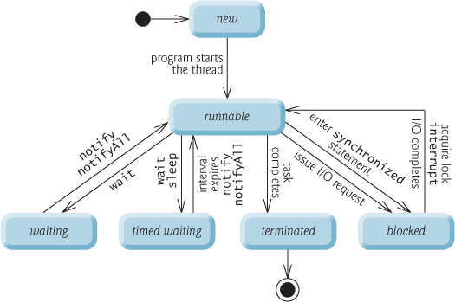
Thread

Slide 86
Thread Priority
MIN_PRIORITY (a constant of 1)
MAX_PRIORITY (a constant of 10).
Default - NORM_PRIORITY (a constant of 5).
thread priorities cannot guarantee and platform dependent

Slide 87
Defining and Starting a Thread
Implement the Runnable interface
Extend the java.lang.Thread class

Slide 88
Runnable interface
public class HelloRunnable implements Runnable {
private String name;
public HelloRunnable(String name) {
this.name = name;
}
public void run() {
System.out.println("Hello Thread: " + this.name);
}
public static void main(String args[]) {
for (int i=0;i<10;i++) {
Thread t1 = new Thread(new HelloRunnable("Thread " + i));
t1.start();
}
}
}

Slide 89
Extend Thread Class
public class HelloThread extends Thread {
private String name;
public HelloThread(String name) {
this.name = name;
}
public void run() {
System.out.println("Hello Thread: " + this.name);
}
public static void main(String[] args) {
System.out.println(Thread.currentThread().getName() + " is running");
for (int i=0;i<10;i++) {
new HelloThread("Thread " + i).start();
}
System.out.println(Thread.currentThread().getName() + " is ended");
}
}

Slide 90
sleep
Causes the currently running thread to block for at least the specified number of milliseconds.

Slide 91
sleep
public class HelloThread extends Thread {
private String name;
public HelloThread(String name) {
this.name = name;
}
public void run() {
System.out.println("Hello Thread: " + this.name);
}
public static void main(String[] args) throws Exception {
for (int i=0;i<10;i++) {
Thread t = new HelloThread("Thread " + i);
t.start();
t.sleep(500);
}
}
}

Slide 92
join
Join is a non static method.
The current thread invokes this method on a second thread, causing the current thread to block until the second thread terminates or the specified number of milliseconds passes.

Slide 93
join
public class HelloThread extends Thread {
private String name;
public HelloThread(String name) {
this.name = name;
}
public void run() {
System.out.println("Hello Thread: " + this.name);
}
public static void main(String[] args) throws Exception {
for (int i=0;i<10;i++) {
Thread t = new HelloThread("Thread " + i);
t.start();
t.join();
}
}
}

Slide 94
wait, notify
wait() tells the calling thread to give up the monitor and go to sleep until some other thread enters the same monitor and calls notify( ).
notify() wakes up the first thread that called wait() on the same object.

Slide 95
Producer, Consumer example
public class Producer implements Runnable {
private Vector<String> message = new Vector<String>();
public synchronized void putMessage(String msg) {
message.add(msg);
System.out.println("put message");
}
public synchronized String getMessage() {
String m = message.firstElement();
message.remove(m);
return m;
}
public void run() {
putMessage(new Date().toString());
}
}
public class Consumer implements Runnable {
private Producer producer;
public Consumer(Producer producer) {
this.producer = producer;
}
public void run() {
System.out.print("get message: ");
String m = producer.getMessage();
System.out.println(m);
}
public static void main(String [] args) {
Producer p = new Producer();
new Thread(p).start();
new Thread(new Consumer(p)).start();
}
}

Slide 96
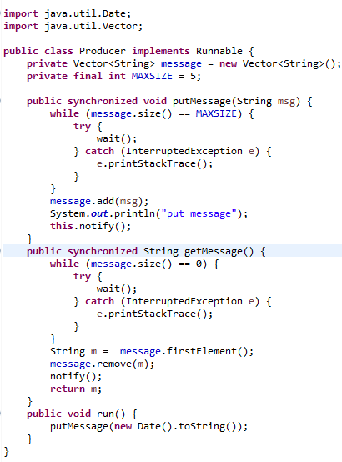
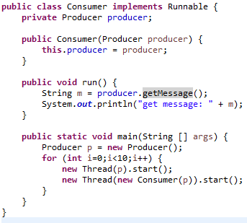
Correction

Slide 97
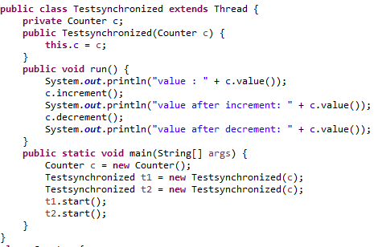
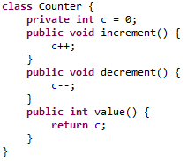
Thread problem

Slide 98
Synchronization
give exclusive access to one thread at a time to code that manipulates a shared object thread at a time
keeps other threads waiting until the object is available.

Slide 99
Synchronization keyword
Instance methods – object lock
Static methods – class lock
Code blocks inside instance methods
Code blocks inside static methods

Slide 100
synchronization declaration - instance
public synchronized void critial() {
// some thread critical stuff
// here
}
public void sample(String site) {
synchronized (this) {
// some thread critical stuff
// here
}
}
}

Slide 101
synchronization declaration - static
public static synchronized void critial() {
// some thread critical stuff
// here
}
public static void sample(String site) {
synchronized (this) {
// some thread critical stuff
// here
}
}
}

Slide 102
Question
How to correct previous bug?

